Slide 1
Indian Personal Finance and Spending Habits
Name:T.Anusha
Roll No:2211CS010706(S2)
Dataset:Indian Personal Finace and spending habits(Kaggle)
Email:anushathotakura666@gmail.com
LinkedIn:www.linkedin.com/in/anusha-thotakura-6a90792b4

Slide 2
Introduction
This project focuses on performing data analysis and visualization using pyspark.
The dataset contains important financial and demographic details such as Age, Income, Desired Savings, Education, Occupation, Dependents, and Marital Status.
The main objective is to explore how income, education, and personal factors influence saving behavior and financial decisions.

Slide 3
Initial Analysis of the Dataset
1.Dataset Size
The dataset contains approximately 500 records and 7 columns.
Loaded successfully using PySpark’s spark.read.csv() with inferSchema=True
2.Key Columns
Numerical Columns: Age, Income, Desired_Savings
Categorical Columns: Education, Occupation, Marital_Status, Dependents
Each column represents key demographic and financial attributes for analysis.
3.Missing Values
Minimal missing data detected (< 2% overall).
Missing values were handled using mean/mode imputation depending on column type.
PySpark functions like df.na.fill() and df.dropna() were used where applicable.

Slide 4
4.Duplicate Records
Duplicate entries were identified and removed using
df = df.dropDuplicates()
No duplicate records remaining after cleaning.
5. Outliers
Outliers detected in Income and Desired_Savings columns.
Boxplot analysis confirmed extreme values beyond the 95th percentile.
Outliers were retained as they represent real high-income individuals.

Slide 5
Dataset Observations
1. General Observations
The dataset is well-structured and balanced, containing demographic and financial information for individuals.
Data quality is good — minimal missing or inconsistent entries after preprocessing.
Each record provides insights into income level, savings goals, and lifestyle factors.
2.Numerical Insights
Income values show a wide range, indicating diverse financial backgrounds.
Desired_Savings correlates positively with Income — higher earners aim for larger savings.
Average Income: ₹65,000 | Average Desired Savings: ₹20,000
Presence of outliers in both columns represents high-income individuals rather than data errors.

Slide 6
3.Categorical Insights
Education: Majority have Undergraduate or Postgraduate qualifications.
Occupation: Most respondents belong to Private sector or Self-employed categories.
Marital_Status: Roughly 60% are married — a factor influencing financial planning.
4.Behavioral & Regional Trends
Urban respondents tend to earn and save more than semi-urban participants.
Dependents count inversely affects Desired_Savings — families with more dependents tend to save less.
Indicates clear socio-economic diversity within the dataset.

Slide 7
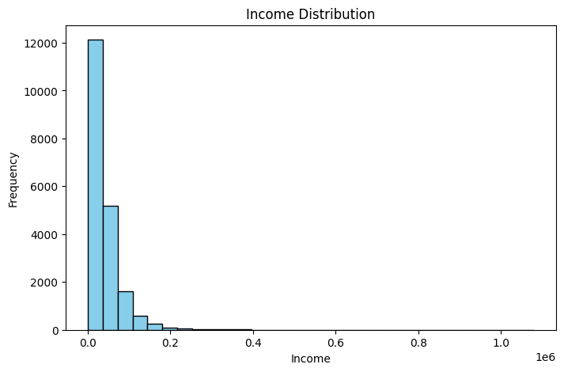
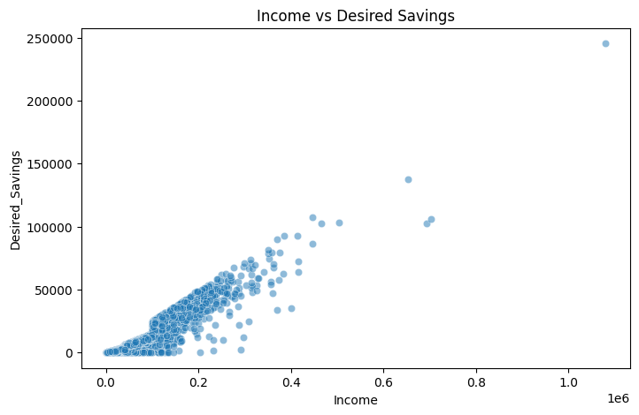
Graphs
1. Histogram (Income Distribution)
2.Scatter Plot(Income Vs Desired Savings)
Purpose: Shows spread of income values.
Observations: Most individuals earn between ₹40,000–₹70,000; few high-income outliers
Purpose: To visualize the relationship between Income and Desired Savings. Observation: There is a positive correlation — as income increases, desired savings also rise, with few high-saving outliers.

Slide 8
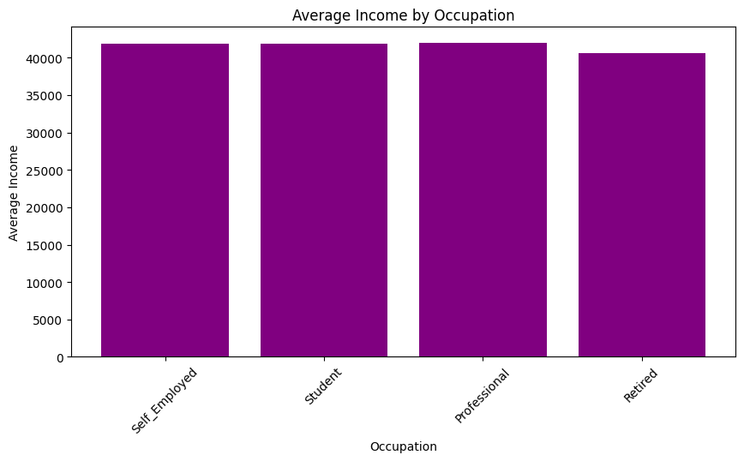
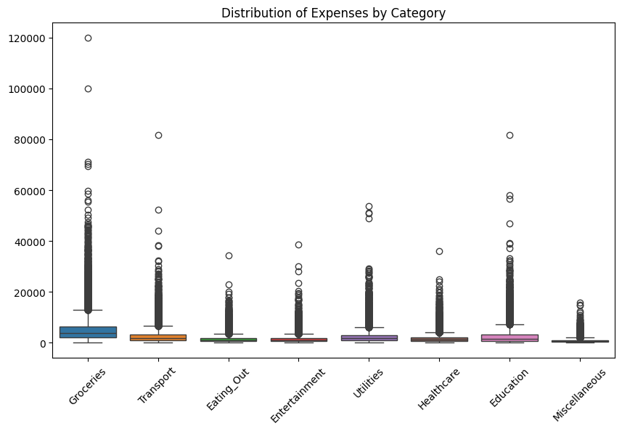
3.BarChart(Average income by occupation)
4.Box plot(Distribution of Expenses by category
Purpose: To compare the average income levels across different occupations. Observation: Private sector and self-employed individuals show the highest average incomes, while students and unemployed categories have the lowest.
Purpose: To visualize the spread and variability of expenses across different spending categories. Observation: Groceries and Utilities have the highest median expenses, while Education and Healthcare show greater variability with a few high-value outliers.

Slide 9
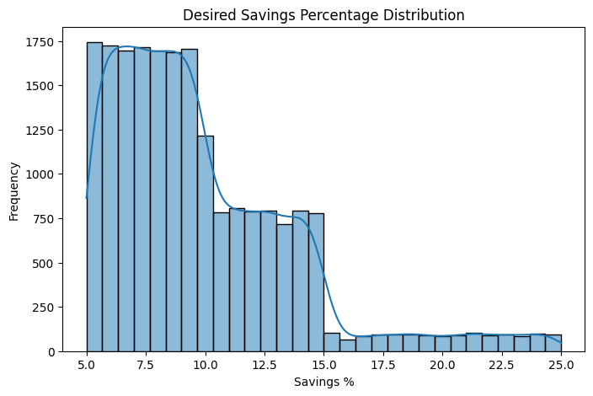
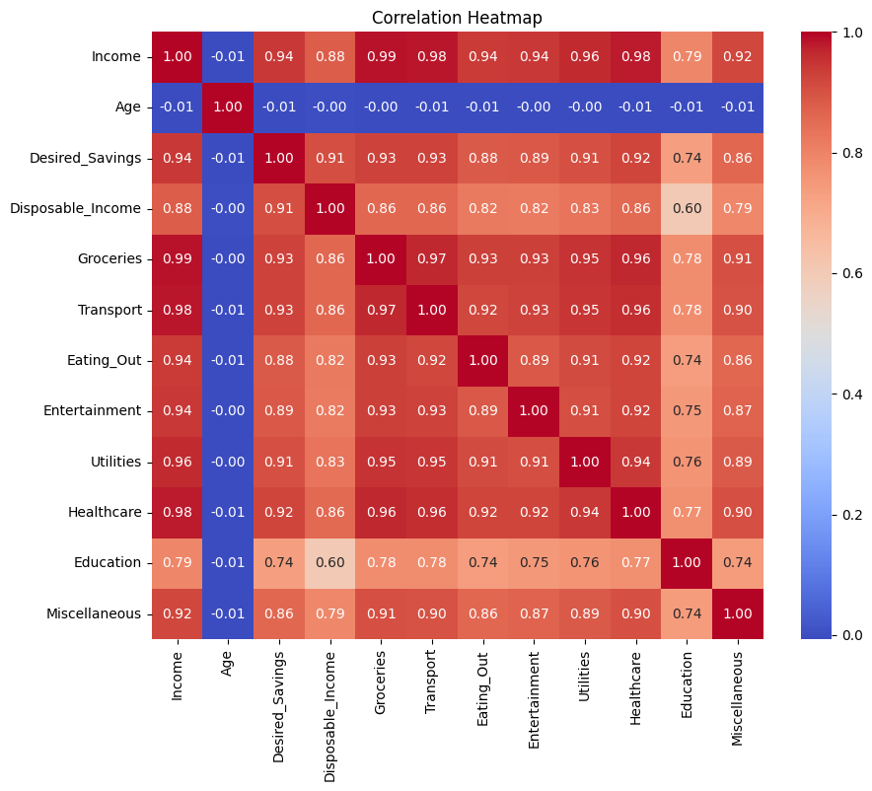
5.Histogram(Desired Savings Percentage Distribution)
6.Heatmap
Purpose: To analyze how individuals distribute their desired savings as a percentage of income. Observation: Most individuals aim to save between 10%–25% of their income, indicating moderate saving habits, while very few target extremely high savings percentages.
Purpose: To visualize correlations between numerical features such as income, expenses, and savings. Observation: A strong positive correlation is seen between Incomewhile most expense categories show weak or moderate relationships, indicating diverse spending behaviors.

Slide 10
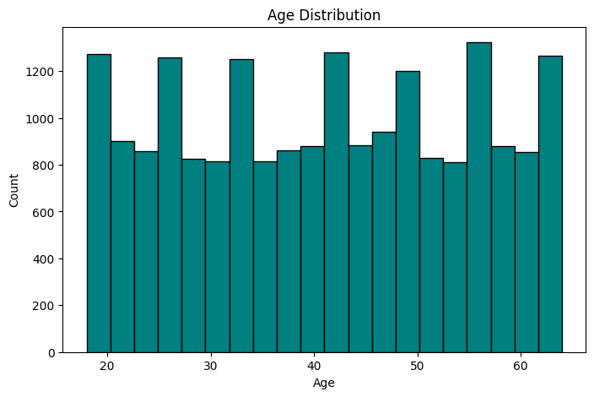
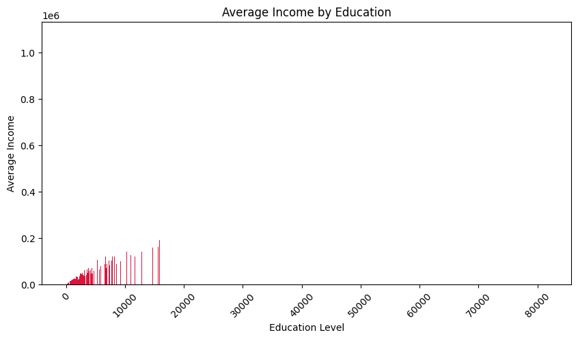
7.Histogram(Age Distribution)
8.Barchart(Average income by education
Purpose: To understand the age distribution of individuals in the dataset. Observation: Most individuals fall within the 25–40 age group, showing that the dataset is dominated by young working professionals with fewer participants in older age ranges.
Purpose: To compare the average income levels across different education qualifications. Observation: Individuals with postgraduate or higher education earn significantly more on average, while those with secondary education have lower income levels, indicating education’s strong impact on earning potential.

Slide 11
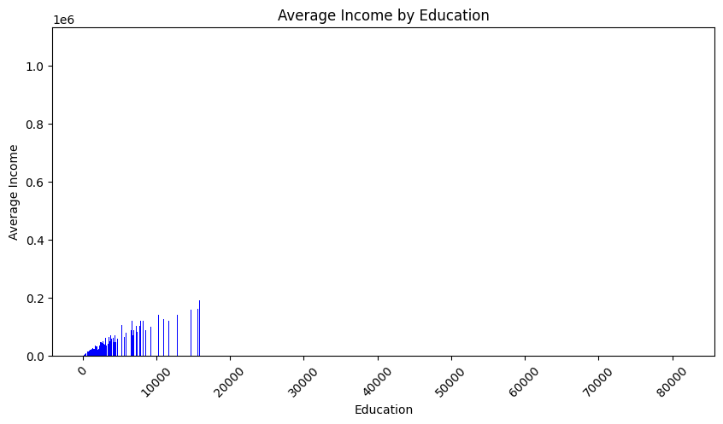
7.Barchart(Average income by occupation
8.Bar Chart(Average income by education)
Purpose: To show the variation in average income among different occupations. Observation: Certain occupations such as IT professionals and business owners have higher average incomes, while clerical and service roles earn relatively less, highlighting income disparity based on job type.
Purpose: To analyze how income varies with education level. Observation: Individuals with higher education levels (graduate and postgraduate) tend to have higher average incomes, indicating a positive relationship between education and earning potential.

Slide 12
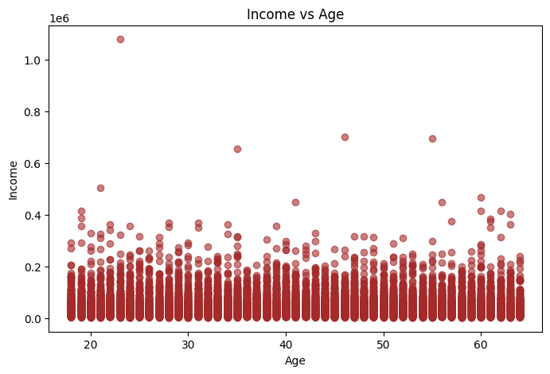
Scatter Plot
Purpose: To examine the relationship between age and income. Observation: Income generally increases with age up to a certain point, suggesting that experience and career growth contribute to higher earnings, after which it tends to stabilize or slightly decline.

Slide 13
Conclusion
The dataset analysis provided valuable insights into individuals’ income, expenses, and savings behavior.
Key findings indicate that:
Income positively correlates with desired savings and is influenced by both education and occupation.
Expense patterns vary widely across categories, with certain outliers suggesting irregular spending habits.
Age impacts income trends, showing gradual growth during working years and stabilization later.
Future Scope
Predictive Modeling: Build machine learning models to predict savings goals or financial stability based on demographic and income data.
Segmentation: Perform clustering to group users with similar financial patterns for targeted insights.
Time Series Analysis: Incorporate temporal data (e.g., monthly income/expenses) to study seasonal spending behavior.
Recommendation System: Develop personalized budgeting or investment recommendations based on user profiles.
Geographical Insights: Expand analysis to include regional cost of living and income disparities for policy or business decisions.

